Slide 1

BES171: Banking, Finance & Insurance
Money Evolution
Monetary Policy
Evolution & Classification of FI
Digital Payment
BASEL, NPA, TBS, Bad Bank-PARA
Finance, Insurance & Fin.

Slide 2
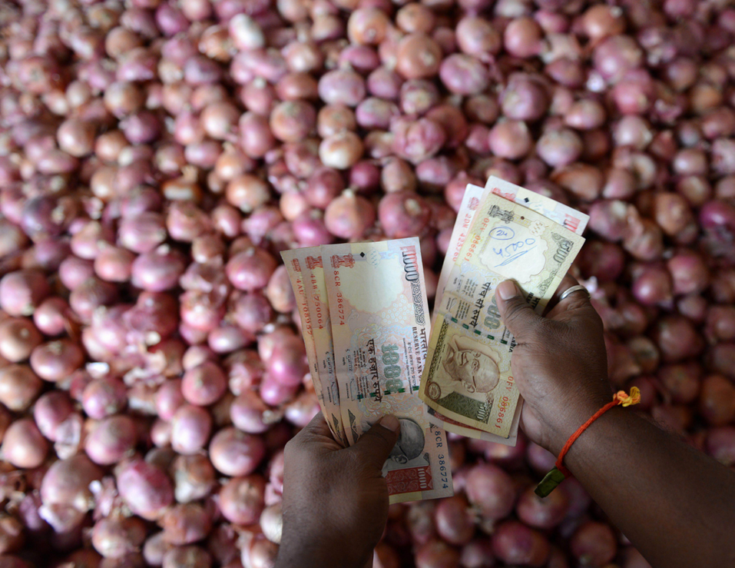
How can RBI control money supply and inflation?
Theoretical aspects
fractional reserve banking & Monetary multiplier

Slide 3

Why not simply store “value” in bonds, gold? Why Demand for Money? because of three motives
Transaction motive
Medium of exchange
Precautionary motive
Sudden Expenditure, impulsive purchase?
Perfectly liquid >> gold >> diamond >>house.
Speculative motive (asset demand)
Waiting for bond/gold/land prices to fall,
Then I will use money to buy.

Slide 4
So people demand money for 3 reasons…but WHERE do they keep it?
A: Currency with Public
B: Demand Deposits in Banks (CA-SA)
[time deposits such as FD- not perfectly liquid]
M1= A + B

Slide 5


Measure of Money Supply M1: Currency with public + Demand Deposits with Bank
Asset
0
Liability
0
In hand
100 rupees.
Because none depositing money
Money Supply (M1):
Bank (0) + Junta (100) =Rs.100

Slide 6
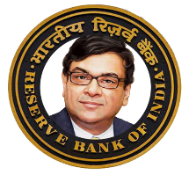
Money Supply M1: Currency with public + Demand Deposits with Bank
Asset
100
Liability
Demand Deposit: 100
100%
Cash reserve ratio
Deposited 100 rupees.
Money Supply (M1):
Bank (100) + Junta (0) =Rs.100

Slide 7



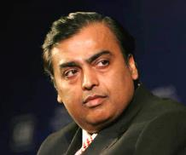
Asset
Reserve: 10
Liability
Deposit: 100
Loan: 90
10%
Cash Reserve Ratio
Chequebook, e-banking, cards, hence even though only Rs.100 printed->system can use 190
Asset
Liability
Deposit:
Rs.90
Reserve:09
Loan:81
M1: Currency with public + Demand deposit
0+ (100 + 90) = 190

Slide 8
Money Multiplier from original deposit of Rs. 100
Asset side:
10% Reserve
1st Bank: 100
Rs.90
10% of 100
2nd Bank: 90
10% of 90
10%of 81
Rs. 81
3rd Bank: 81
Rs.72.90
…
Total
Rs.1000
Rs.100 (Total Reserve)
Loaning
With 100 rupee of “reserve”, banking system generates Rs.1000..hence money multiplier is (10x)

Slide 9
Every “R” reserve generates “1/r” new money
Reserve Ratio “R”
Multiplier (1/r)
1x
10x
100%=1
20x
10% = 1/10
5%=1/20
4%=1/25
25x
Money multiplier is always greater than “1” in a functional economy
Higher the reserve ratio…lower the money supply

Slide 10
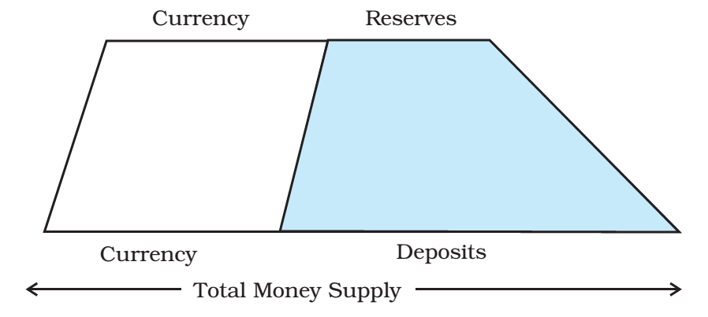
In a functional economy, Money multiplier is always greater >1

Slide 11
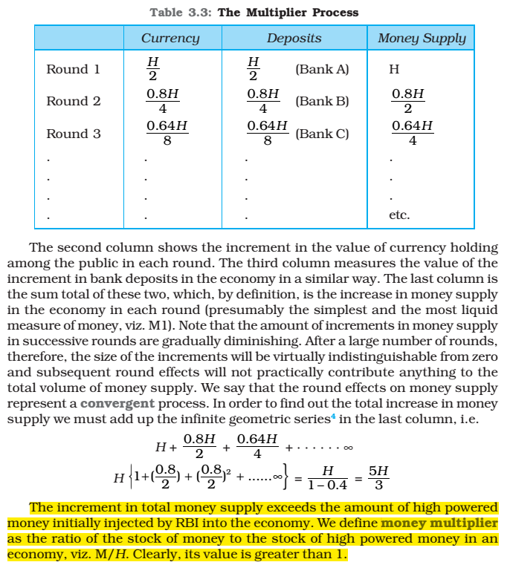
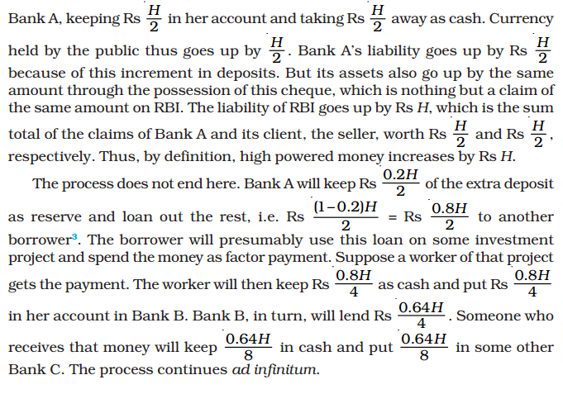
NCERT
Class 12
MacroEconomics
Ch.3

Slide 12


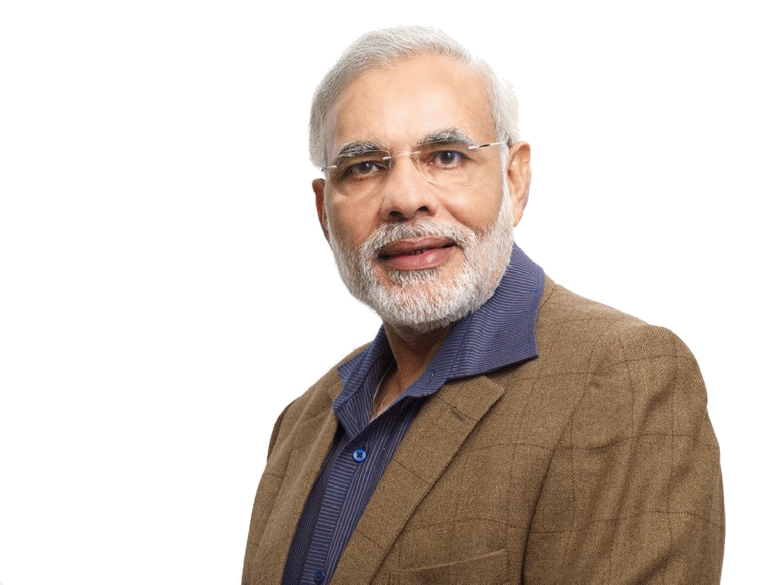

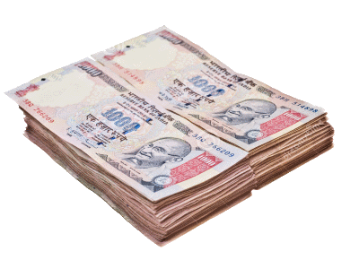



Back to the first diagram…
M0: reserve money
High powered money
Asset
Reserve: 10
Liability
Deposit: 100
Loan: 90
Currency with public
M1: Currency with Public + Demand Deposits

Slide 13

RBI’s Balance sheet
Asset
Gold
Liability
Foreign Exchange Reserve
Govt Securities
Loans to Banks
Currency in circulation, [+bank, public]
Bankers deposit to RBI
Govt's deposit to RBI
Vault cash with banks
M0 or Reserve Money or High powered money

Slide 14
Back to the first diagram…
Asset
Liability
M0: reserve money
High powered money
Asset
Reserve: 10
Liability
Deposit: 100
Loan: 90
Currency with public
M1: Currency with Public + Demand Deposits

Slide 15
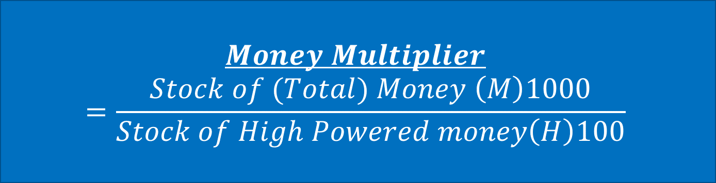
M0 or Reserve Money or
High powered money (H)
$$Money Multiplier$$
$$=\frac{Stock of (Total) Money \left(M\right)1000}{Stock of High Powered money\left(H\right)100}$$

Slide 16
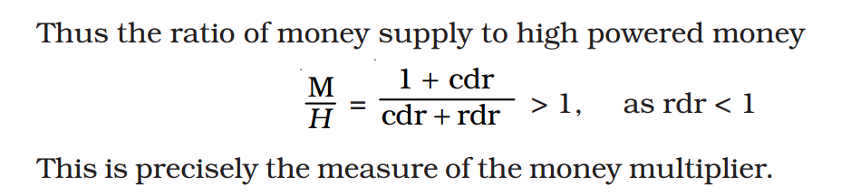
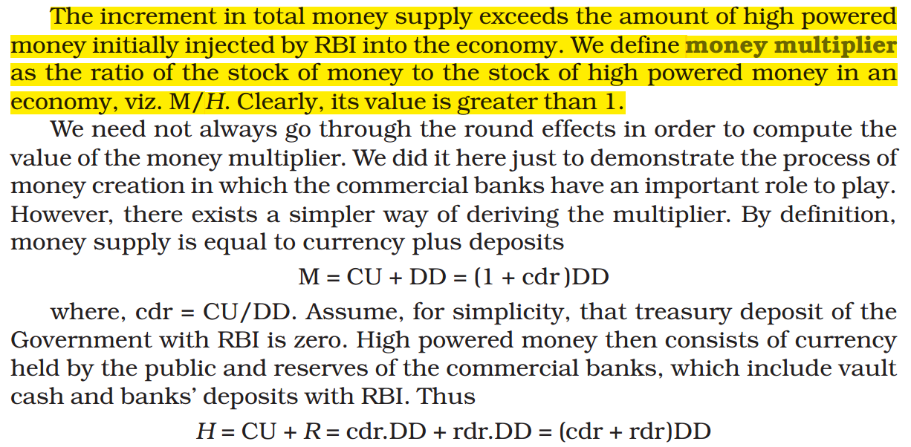
NCERT Class 12 Macroeconomics Ch.3

Slide 17
Reserve + Repo Rate=
Asset
Liability
Repo Loans to Banks
M0: reserve money
High powered money
Asset
Reserve: 10
Liability
Deposit: 100
Loan: 90
Repo:__
Currency with public
M1: Currency with Public + Demand Deposits

Slide 18





Narrow Money
Broad Money
M2
M4
= M3+ Post office (TOTAL)
= M1+ Post office (Only Savings)
M3 (broad)
Most commonly used measure.
“Aggregate mon. resources”
Currency
with Juntaa
DEMAND
DEPOSITS
TIME
DEPOSITS
M1: NARROW
Liquidity: M1 > M2 > M3 > M4
M0: reserve money or high powered money

Slide 19
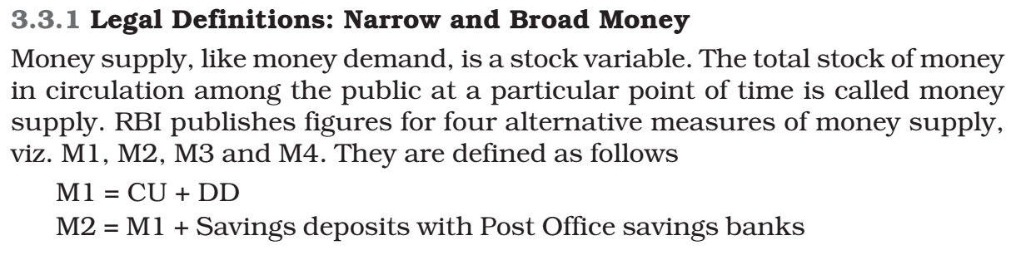
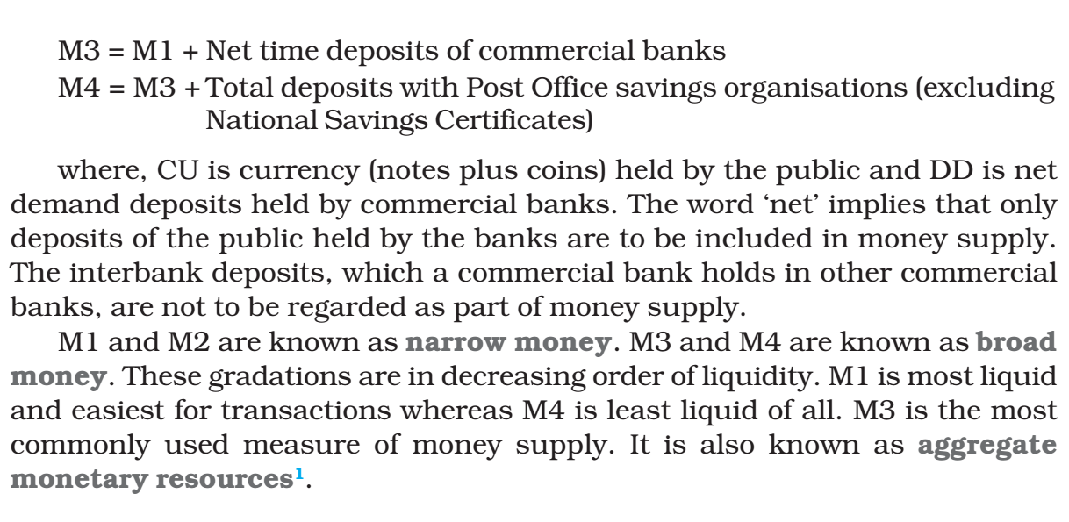
NCERT Class12 Macroeconomics

Slide 20
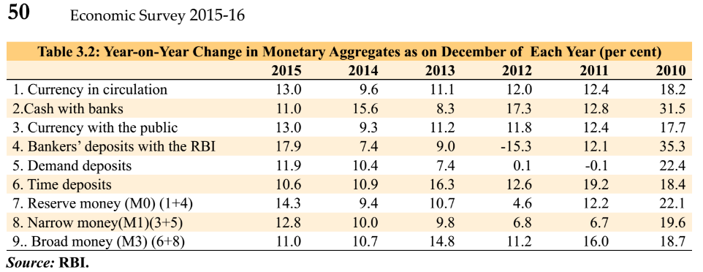
In practical sense:
M0: reserve money [components given above]
M1: narrow money
M3: broad money
M2, M4 (post office) not that focused

Slide 21
What we’ve learned?
RBI creates high powered money (M0)
Bank deposits, Reserve ratio & Repo Rates...
Money multiplier effect: liquidity
In simplest terms
RBI can control money supply
Using monetary policy

Slide 22
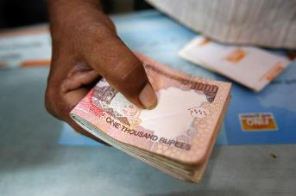

Supply Demand
1 kg = Rs.100
Supply
Demand

Slide 23
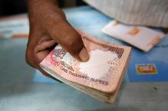



DD/RG Suitcase lelo Yojana= Inflation
Demand
Demand
1 kg = Rs.1000
Supply
Demand
Demand

Slide 24
To combat Inflation: increase supply
Demand
Demand
1 kg = Rs.100
Supply
Demand
Demand

Slide 25
To combat inflation: Reduce demand by ▼ money supply
Demand
Demand
1 kg = Rs.100
Supply
Demand
Demand

Slide 26

Neutral Monetary Policy: “stable inflation”, max. GDP & Employment
2%
6%
4%
Fight deflation
Increase Money supply
Easy Money policy
Cheap money policy
Fight inflation
Reduce Money supply
Tight Money policy
Dear money policy
Dovish Policy
Hawkish Policy

Slide 27



Deflation is also not good
1 kg = Rs.1
1 kg = Rs.100
Supply
Demand
Unemployment, GDP down… Recession
RBI has to increase money supply / reduce interest rates

Slide 28
Neutral Monetary Policy: “stable inflation”, max. GDP & Employment
2%
6%
4%
Fight deflation
Increase Money supply
Easy Money policy
Cheap money policy
Fight inflation
Reduce Money supply
Tight Money policy
Dear money policy
Dovish Policy
Hawkish Policy

Slide 29
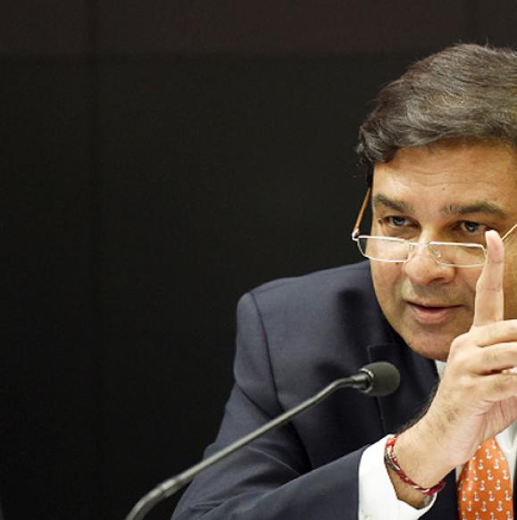
Monetary Policy: Tools & their limitations
Quantitative/Gen./Indirect
Qualitative: Selective, Direct
Ratios: SLR, CRR, incremental CRR
Margin requirement/ LTV
OMO & MSS
Rates: Bank, MSF, LAF [Repo, RR]
Consumer Credit control / EMI
Selective Credit Control (SCC), Credit ceiling & Rationing, PSL
Moral Suasion & Direct Action
Review of last year’s Policies
NEXT

